Slide 1
Music recommendations system
Group Members :
1.Ms. Sejal Subhash Patil
2.Ms Sayali Mohan Takalkar
3.Miss.Nargis Banu . B
4.Ms.Sabah Alia R
5.Mohammadu Azeezurrahmansayeedi
6.Mr.George R
7.Mr Sachin

Slide 2
Contents
Project Architecture
Introduction
Data set Details
Data preprocessing and EDA
Visualization
Details about recommendation techniques
Model Evaluation
Deployment
Reference

Slide 3
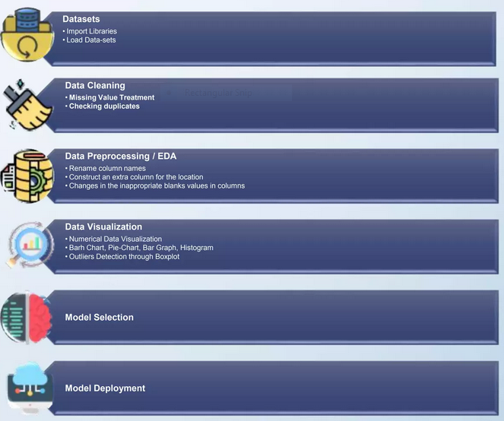
1. Project Architecture

Slide 4
2. Introduction
A Music Recommendation System revolutionizes the music listening experience by offering personalized song suggestions, utilizing algorithms that analyze user preferences and behaviors. By processing individual interactions and historical data, the system curates tailored playlists, introducing users to new artists and tracks aligned with their tastes. This not only enhances user satisfaction but also fosters a deeper connection between listeners and their music libraries, creating a more engaging and enjoyable musical journey.

Slide 5
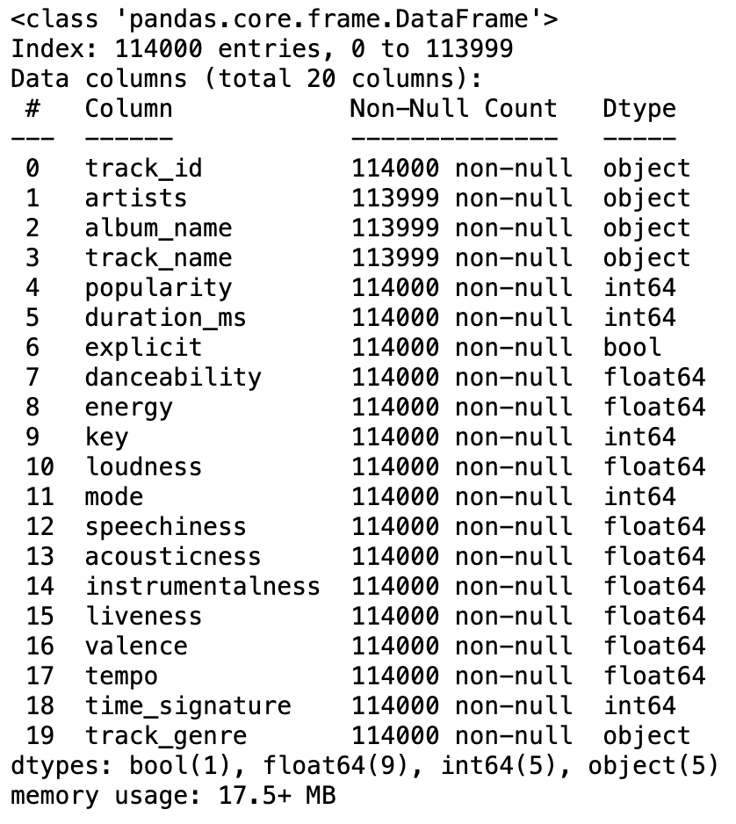
3. Datasets Details
Book Dataset No. of rows : 114000 NO. of columns : 20

Slide 6
4. Data preprocessing and EDA
Music data preprocessing readies the data for analysis by converting audio files, extracting key features, and addressing data issues. Exploratory Data Analysis (EDA) involves visualizing patterns and relationships in the data. Both are essential to uncover insights and make informed decisions in music data analysis.

Slide 7
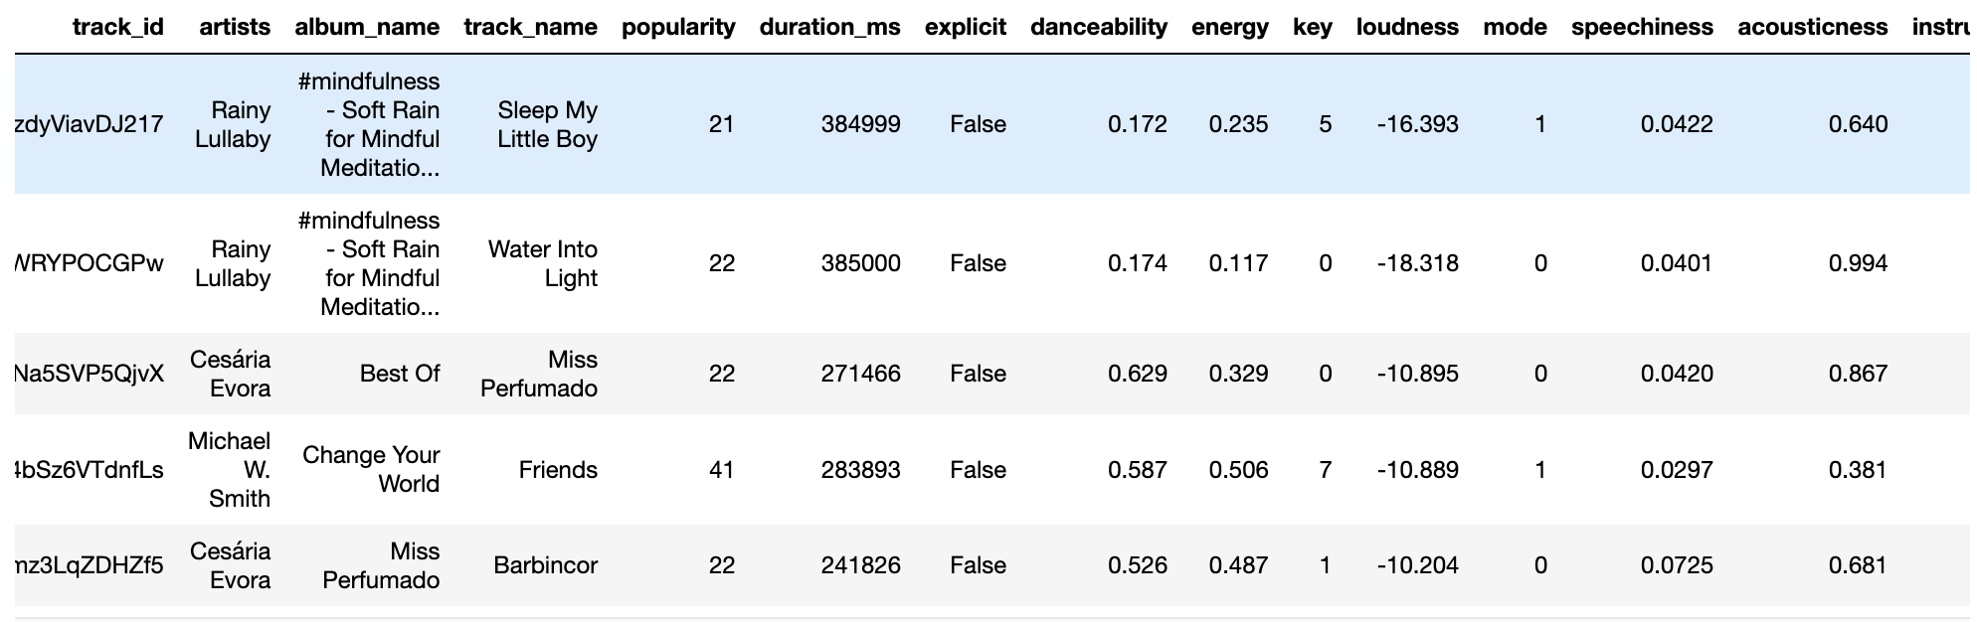
Final Dataset Details
After applying preprocessing on dataset,
Track_id : Number of unique entries: 89740
Artists : Number of unique entries: 31437
Album_name : Number of unique entries: 46589
Track_name : Number of unique entries: 73608
Track_genre : Number of unique entries: 114

Slide 8
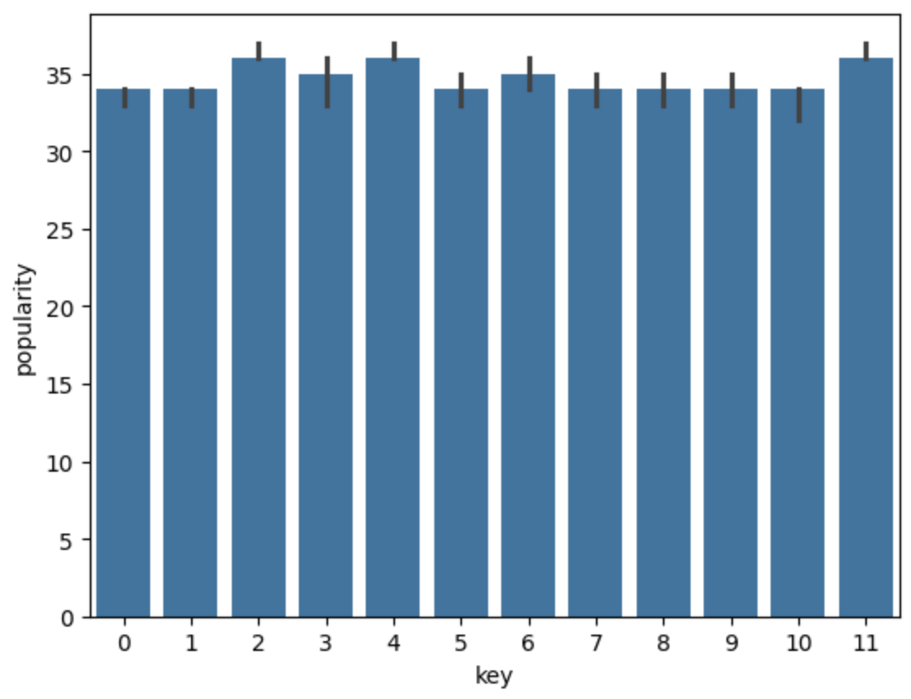
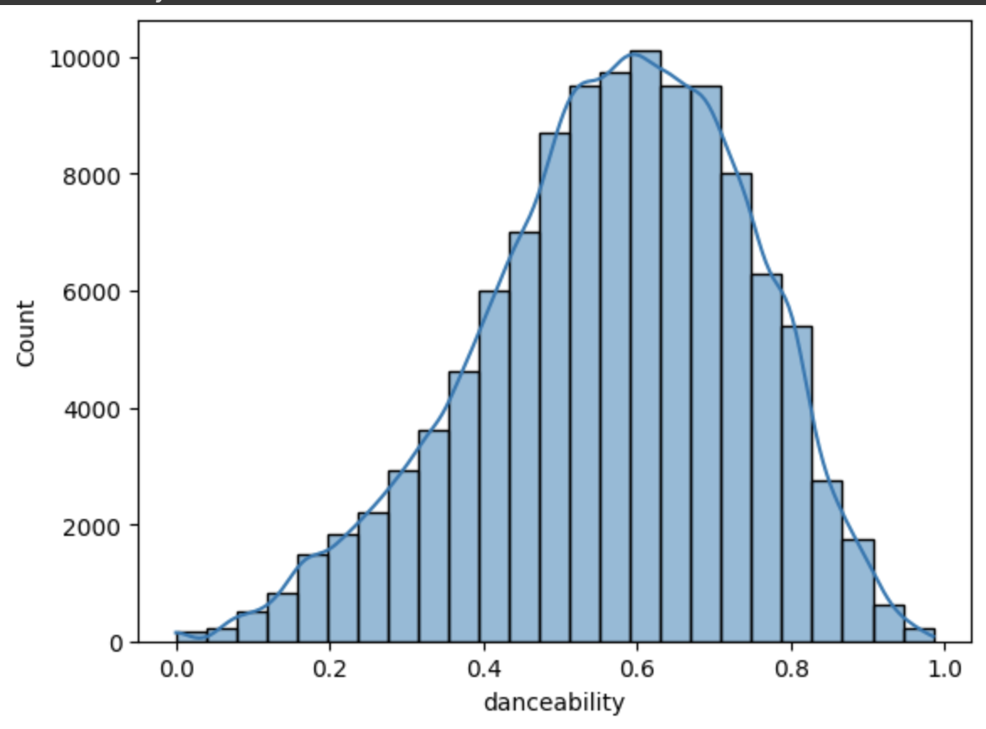
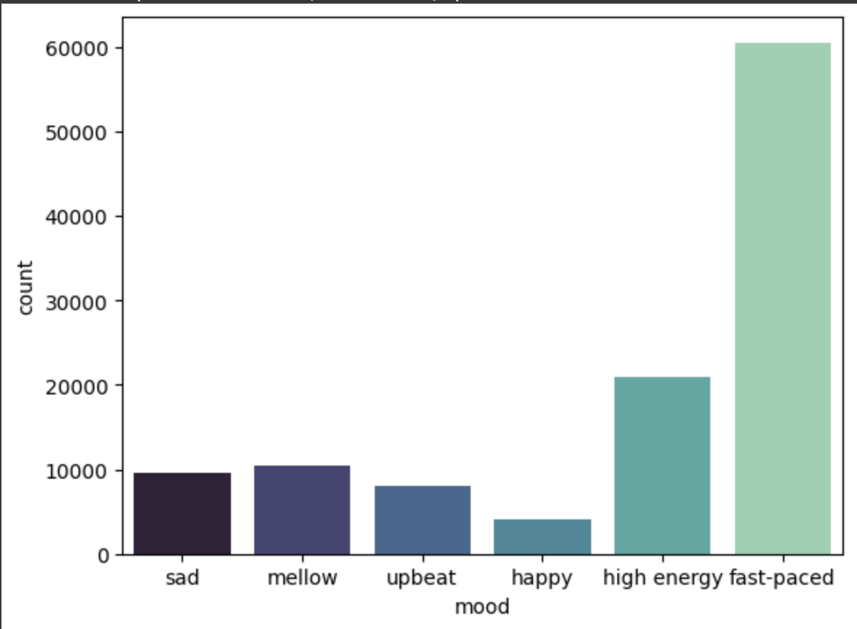
5. Visualization
Barplot;
Histplot;
Categories for the mood variable;

Slide 9
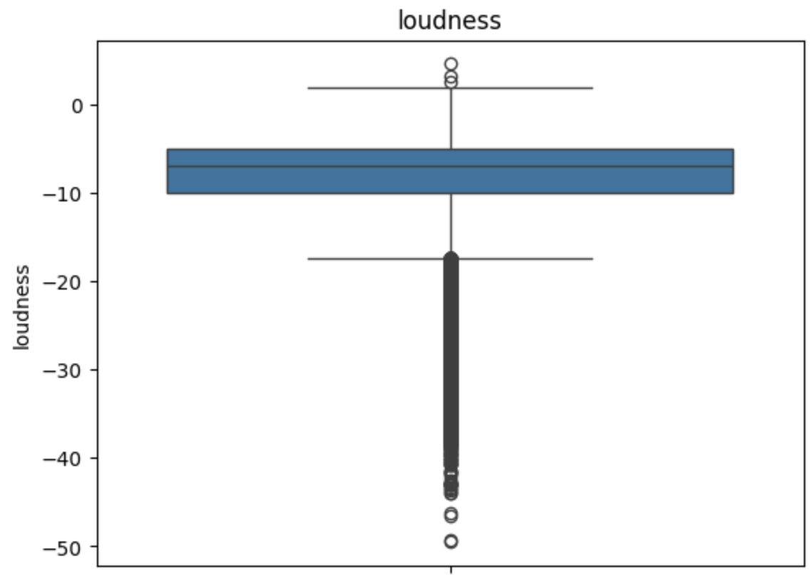
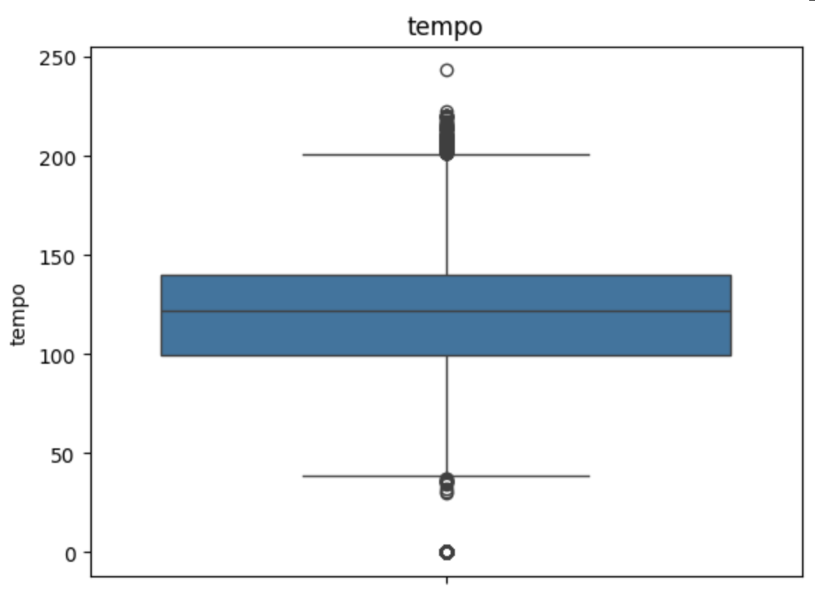
Outliers
There are many outliers in loudness column
Outliers are treated with mean value

Slide 10
6. Recommendation Techniques
Popularity-based Music Recommendation System:
A Popularity-Based Music Recommendation System is a straightforward approach to suggest songs to users based on their overall popularity within a platform. This system doesn't consider individual user preferences but rather recommends music that is widely liked or frequently accessed by the general audience. Its advantage lies in its simplicity and minimal computational requirements, making it easy to implement. However, its key limitation is the lack of personalization, as recommendations are not tailored to individual tastes. This system is suitable for broad audience preferences but may not provide the depth of personalized recommendations found in more advanced recommendation models.

Slide 11
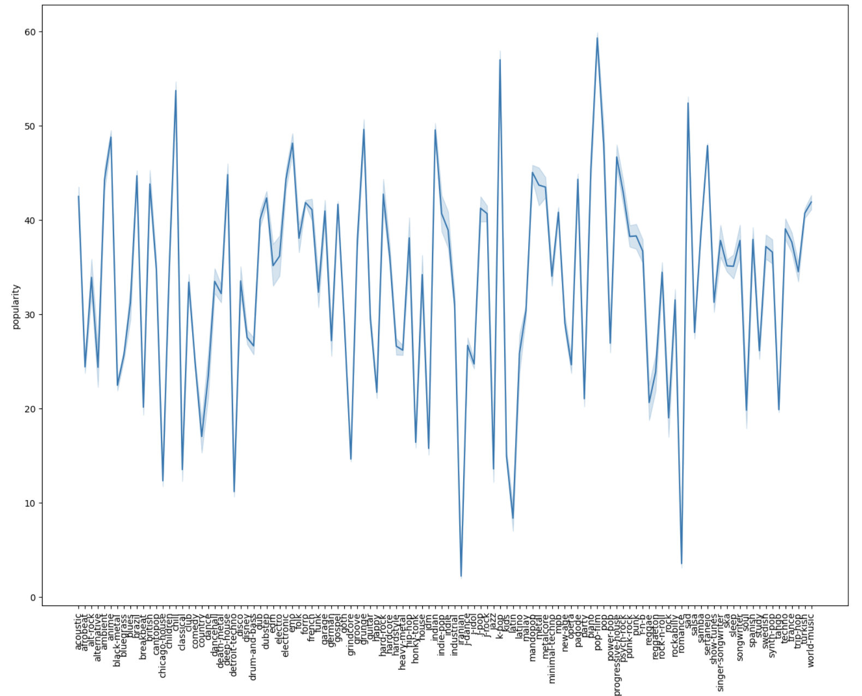
Popularity-based Music Recommendation System:

Slide 12
Advantages
Simple implementation.
Requires minimal computational resources.
Easy to deploy and maintain.
Disadvantages
Lacks personalization.
Recommendations are based on overall popularity.
May not cater to individual user preferences or niche tastes.

Slide 13
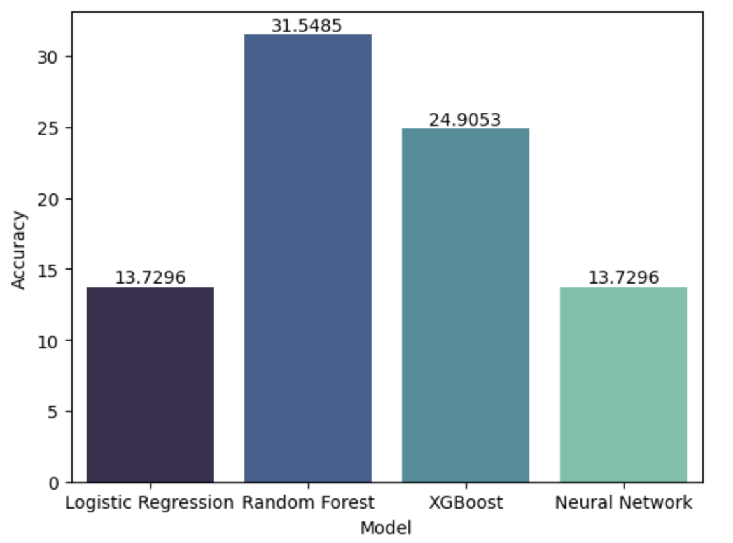
Model evaluation
Tried different model building and KNN gave
the best result, so moved forward using
K Nearest Neighbors Algorithm

Slide 14
8. Deployment
﻿Deployment is the process by which a ML model is moved from an offline environment and integrated into an existing production environment, such as a live application. It is a critical step that must be completed in order for a model to serve its intended purpose and solve the challenges it is designed for.

Slide 15
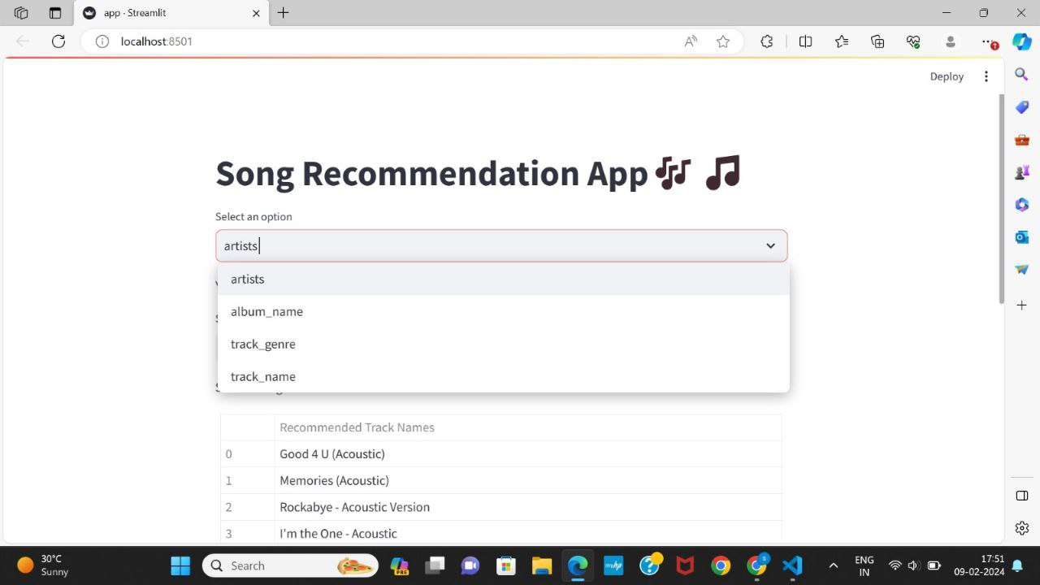
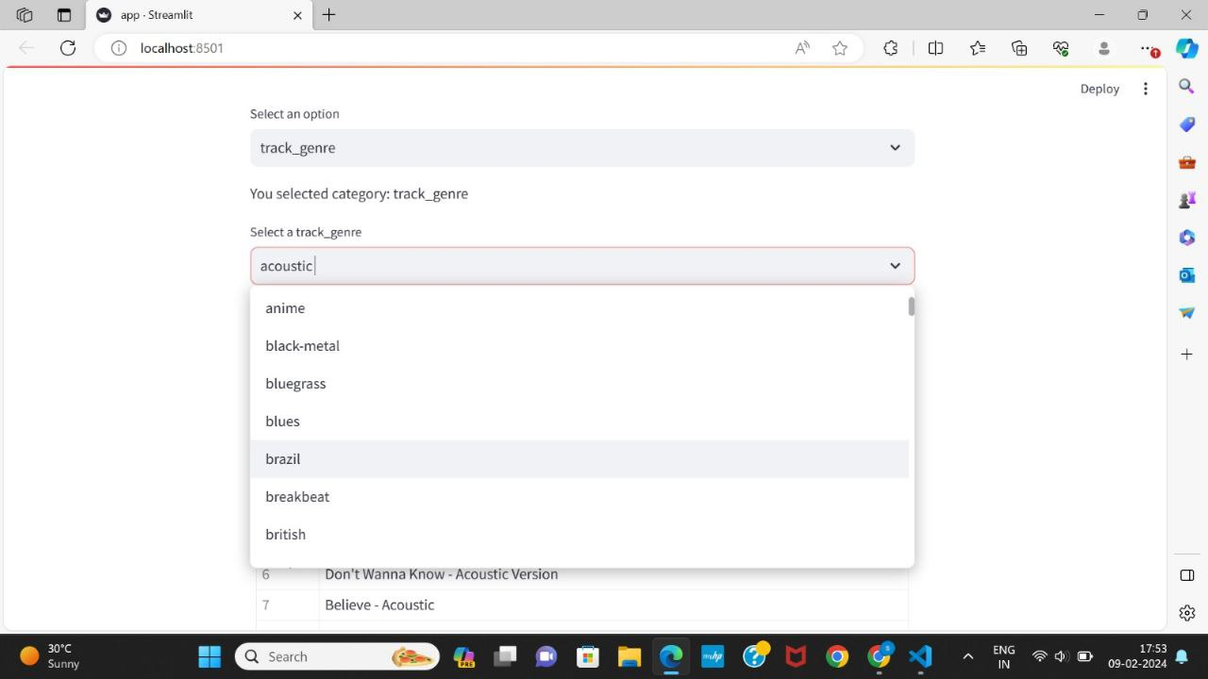
Using Streamlit we have deployed our application

Slide 16
8. Reference
﻿Pandas documentation link:- https://pandas.pydata.org/docs/getting started/index.html
Matplotlib documentation:- https://matplotlib.org/stable/index.html
Streamlit documentation:- https://docs.streamlit.io/library/get-started/main-concepts
Visual studio code :- https://code.visualstudio.com/learn
KNN documentation:- https://scikitlearn.org/stable/modules/generated/sklearn.neighbors.KNeighbors Classifier.html

Slide 17
Thank You

